Slide 1
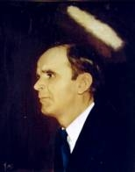

492
FOR BY GRACE
For by grace are ye saved
Through faith,
And that not of yourselves,
It is the gift of God.
Not of works,
Lest any man should boast,
For by grace are ye saved,
Through faith.

